Slide 1
Association and Simple Linear Regression
Lecture 01 Brandon M. Greenwell

Slide 2
Reading assignment
Chapter: 1
Sections: 1.1 – 1.8
Main topics:
Association 😪
Simple linear regression

Slide 3

Read the 📖!

Slide 4
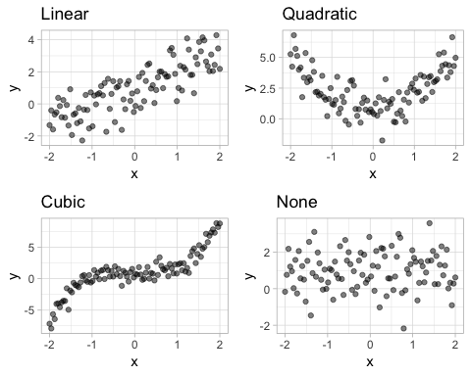
Statistical relationships

Slide 5
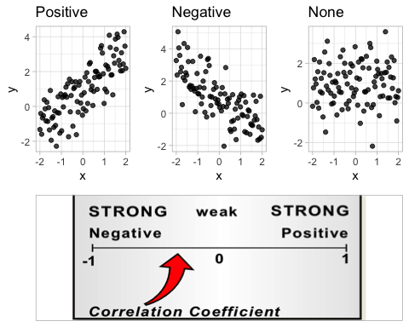
Pearson correlation

Slide 6
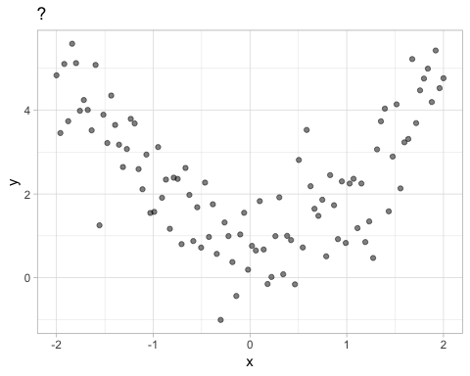
Pearson correlation

Slide 7
Pearson correlation
The (Pearson) correlation coefficient (also called the Pearson product-moment correlation coefficient) between two random variables $X$ and $Y$ is given by $Cor\left(X,Y\right)=ρ=Cov\left(X,Y\right)/\left(σ_{X}σ_{Y}\right)$
Given a sample ${\left\{\left(x_{i},y_{i}\right)\right\}}_{i=1}^{n}$, we estimate $ρ$ with $r=S_{xy}/\sqrt{S_{xx}S_{yy}}$
Where, for example, $S_{xy}=\sum_{i=1}^{n}{\left(x_{i}−\overline{x}\right)}\left(y_{i}−\overline{y}\right)$

Slide 8
Pearson correlation
It is common to test the hypothesis $H_{0}:ρ=0$ vs. $H_{1}:ρ≠0$
Rejecting $H_{0}$ is only evidence that $ρ$ is not exactly zero
A p-value does not measure the magnitude of the (linear) association
Sample size affects the p-value! 😱
There is a formal relationship between Pearson’s correlation and the simple linear regression (SLR) model
Simple linear relationships can be described by a slope and intercept

Slide 9
Cautions in interpretting correlation(s)
Correlation between $X$ and $Y$ does not imply causation
It does not imply the direction of any possible causal relationship between $X$ and $Y$
There might be a third (lurking) variable that is the cause of changes in both variables (i.e., the association between $X$ and $Y$ might be indirect)
The Pearson correlation only measures the linear association between $X$ and $Y$

Slide 10
Correlation does NOT imply causation
Correlation and uncontrolled experiments
Other examples

Slide 11

If you get the joke in this comic, then you probably undestand enough about correlation!

Slide 12
Which of the following statement(s) is/are true?
The Pearson correlation coefficient is a measure of linear association
A non-significant p-value for a Pearson correlation means no relationship
A negative Pearson correlation indicates a low degree of linear association
A random cloud of data implies a negative correlation.

Slide 13
Which of the following statement(s) is/are true?
The Pearson correlation coefficient is a measure of linear association
A non-significant p-value for a Pearson correlation means no relationship
A negative Pearson correlation indicates a low degree of linear association
A random cloud of data implies a negative correlation.

Slide 14
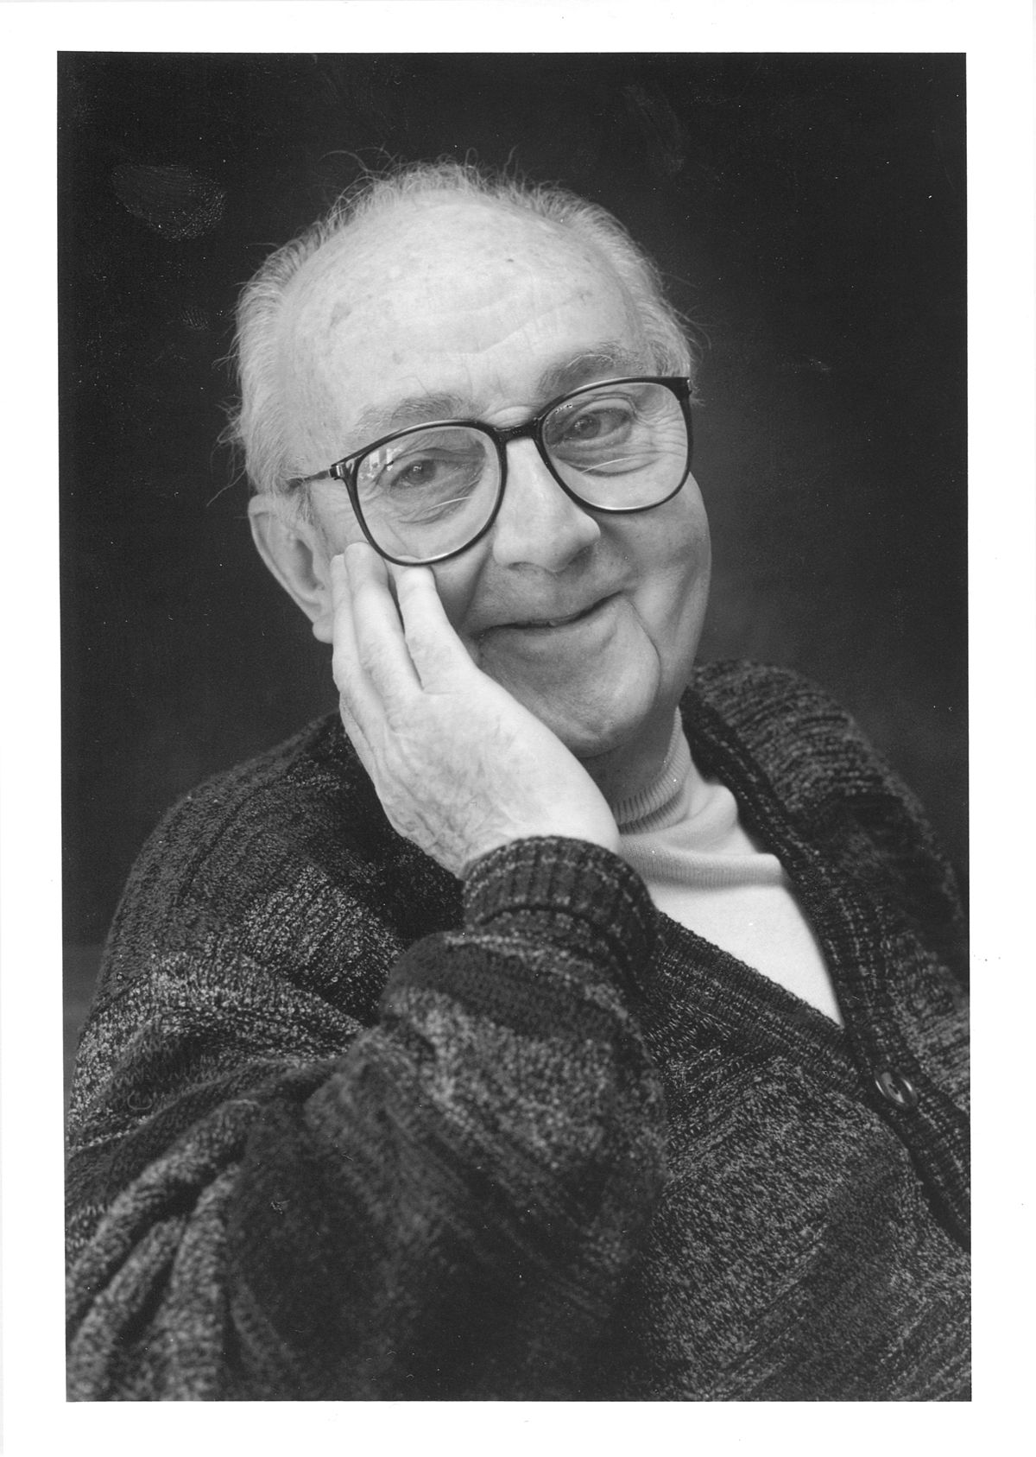
“All models are wrong, but some are useful.”
George E. Box

Slide 15
Historical origins of regression
First developed by Sir Francis Galton in the later part of the 19th century
Studied heights of parents and their children
Noted that the heights of children with tall/short parents tended to “revert” or “regress” to the mean of the group
The term “regression” persists to this day!

Slide 16
Historical origins of regression
install.packages(c("ggplot2", "HistData")) library(ggplot2) ggplot(HistData::Galton, aes(x = parent, y = child)) + geom_point(alpha = 0.5) + geom_smooth(method = "lm", formula = y ~ x, se = FALSE) + geom_abline(intercept = 0, slope = 1, linetype = "dashed") + labs(x = "Height of mid-parent (in)", y = "Height of child (in)")

Slide 17
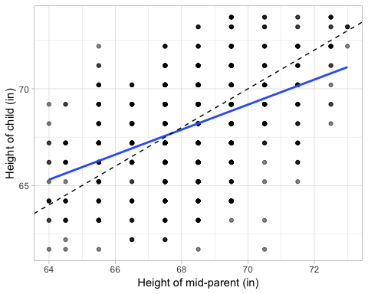
Historical origins of regression

Slide 18
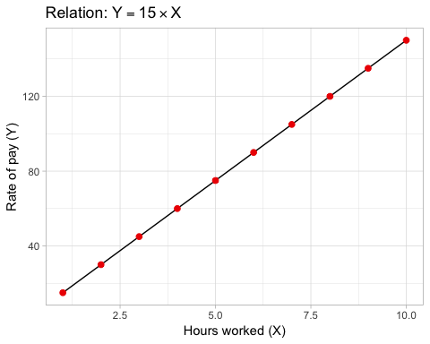
Functional relationships

Slide 19
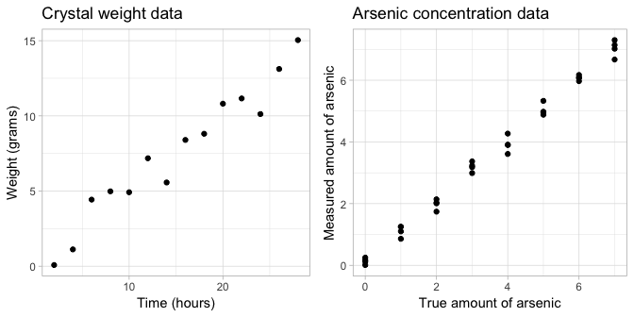
Statistical relationships

Slide 20
Examples of statistical relationships
Simple linear regression (SLR)
$Y=β_{0}+β_{1}X+ϵ$
Multiple linear regression (MLR)
$Y=β_{0}+β_{1}X_{1}+β_{2}X_{2}+…+β_{p}X_{p}+ϵ$
$Y=β_{0}+\sum_{i=1}^{p}{β_{p}}X_{p}+ϵ$
Polynomial regression (of degree $p$)
$Y=β_{0}+\sum_{i=1}^{p}{β_{p}}X^{p}+ϵ$
Nonlinear regression
$Y=\frac{β_{1}X}{β_{2}+X}+ϵ$

Slide 21

Still with me?

Slide 22
Simple linear regression (SLR)
Data: ${\left\{\left(X_{i},Y_{i}\right)\right\}}_{i=1}^{n}$
Model: $Y_{i}=β_{0}+β_{1}X_{i}+ϵ_{i}$
$Y_{i}$ is a continuous response
$X_{i}$ is a continuous predictor
$β_{0}$ is the intercept of the regression line (also called the bias term)
$β_{1}$ is the slope of the regression line
$ϵ_{i}∼iid\left(0,σ^{2}\right)$

Slide 23
Assumptions about the errors
For $i/j=1,2,…,n$
$E\left(ϵ_{i}\right)=0$
$Var\left(ϵ_{i}\right)=σ^{2}$ (homoscedacticity 😱)
$Cov\left(ϵ_{i},ϵ_{j}\right)=0$ (independence)
Assumptions 1.–3. can be summarized as $ϵ_{i}∼iid\left(0,σ^{2}\right)$

Slide 24
Properites of SLR
Simple linear regression: $Y_{i}=β_{0}+β_{1}X_{i}+ϵ_{i}$
Implies the model is linear in the regression coefficients $β_{0}$ and $β_{1}$
The error term is a random variable; hence, $Y_{i}$ is also a random variable (Why? 🤔)
What is $E\left(Y_{i}|X_{i}\right)$ and $Var\left(Y_{i}|X_{i}\right)$?
$Cor\left(Y_{i},Y_{j}\right)=0$ $∀i≠j$ (Why? 🤔)

Slide 25
The SLR model with normal errors
$$Y_{i}=β_{0}+β_{1}X_{i}+ϵ_{i}, i=1,2,…,n$$
where $ϵ_{i}\overset{iid}{∼}N\left(0,σ^{2}\right)$, is equivalent to
$$Y_{i}\overset{iid}{∼}N\left(β_{0}+β_{1}X_{i},σ^{2}\right), i=1,2,…,n$$
$μ_{i}=β_{0}+β_{1}X_{i}$ is called the linear predictor (LP)

Slide 26
Interpretting the regression coefficients
$β_{0}$ is the y-intercept (or bias term)
It represent the mean response when $X=0$; that is $β_{0}=E\left(Y|X=0\right)$
In general, the intercept is of little practical interest (this is especially true in MLR or when zero is not a valid value of $X$)
$β_{1}$ is the slope of the regression line
The slope of a line represents a rate of change
It represents the change in the mean response per one-unit increase in $X$

Slide 27
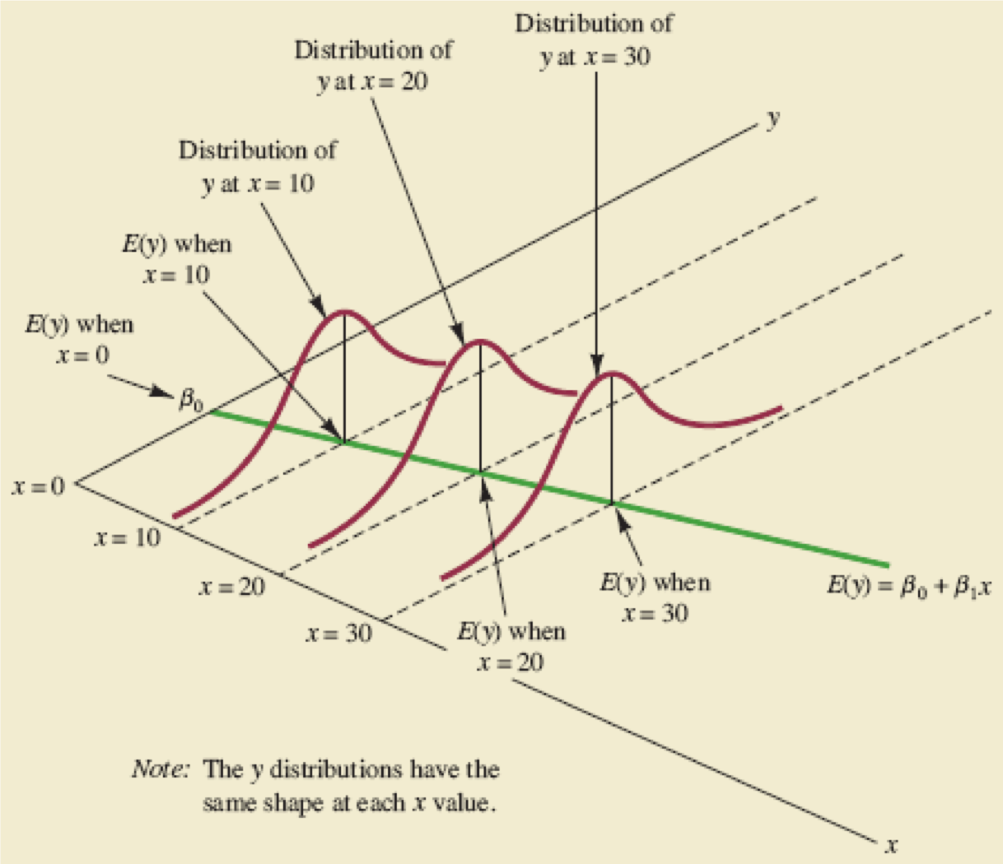

Slide 28
